Slide 1
Design Tradeoffs for SSD Performance
Nitin Agrawal∗, Vijayan Prabhakaran, Ted Wobber, John D. Davis, Mark Manasse, Rina Panigrahy
Microsoft Research, Silicon Valley
∗University of Wisconsin-Madison
2023.07.21
Presentation by Shin Suhwan, 쥬용지에
shshin@dankook.ac.kr

Slide 2
Introduction
Background
SSD Basics
Simulation
Wear-leveling
Conclusion

Slide 3
Introduction
Data placement
Parallelism
Write ordering
Workload management

Slide 4
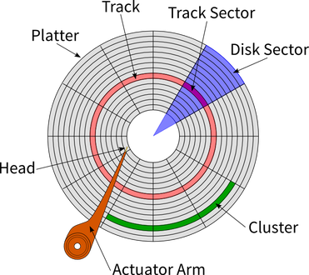
Data Placement
How does data placement affect the performance of storage?
In HDD, the data read/write speed is higher on the outer tracks compared to the inner tracks.
HDD

Slide 5
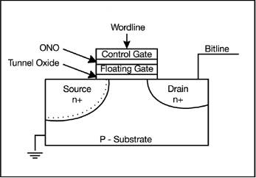
Data Placement
How does data placement affect the performance of storage?
NAND Flash Memory Cell

Slide 6
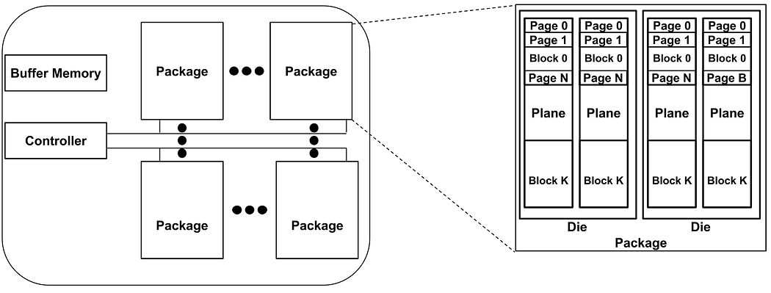
Data Placement
How does data placement affect the performance of storage?
In an SSD, frequent write or erase operations on a specific block can accelerate its aging.
SSD

Slide 7
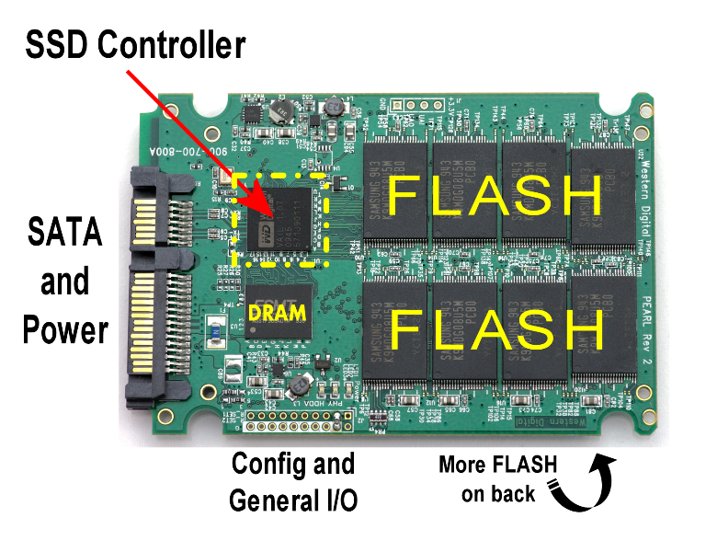
Parallelism
Serial tasks may not fully exploit the performance capabilities of an SSD.

Slide 8
Write ordering
Exploring write ordering and mitigating random writes in SSDs.

Slide 9
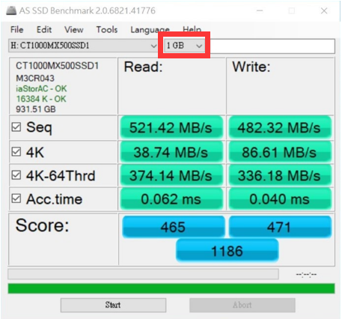
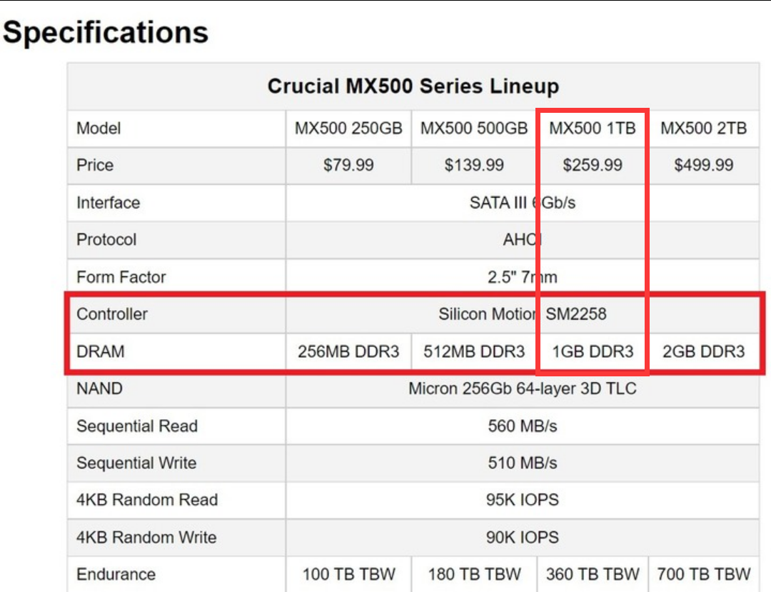
Write ordering
Exploring write ordering and mitigating random writes in SSDs.
Considering factors such as random memory addressing, access time, and request time, SSDs still have slower random write speeds compared to sequential writes, even when using a write buffer.
*This is especially true when performing out-of-cache writes.
Write Merging

Slide 10
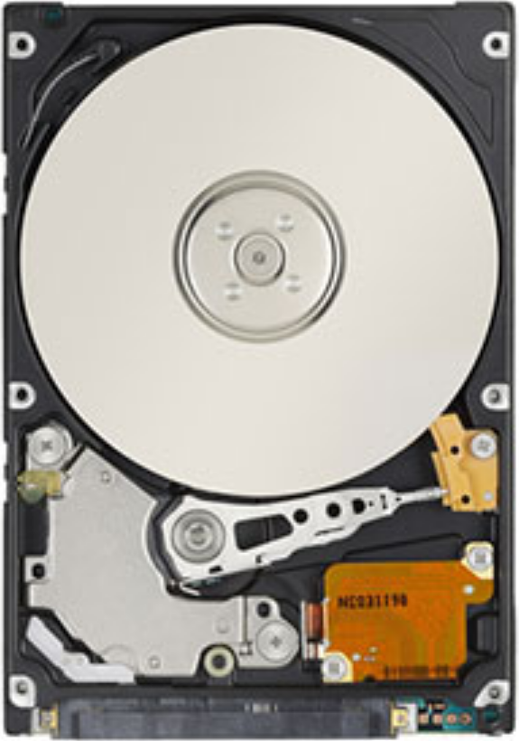
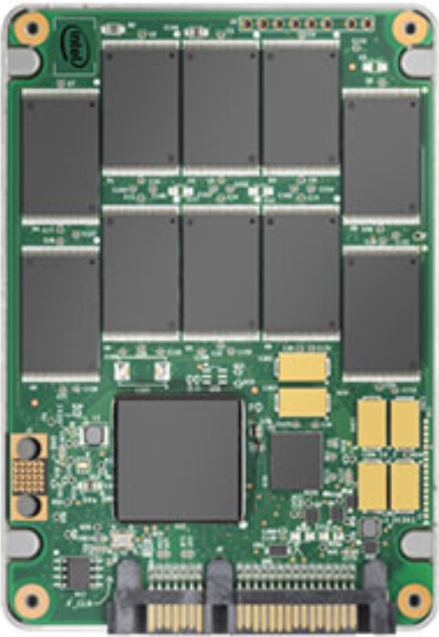
Workload Management
Workload Dependency in Performance.
Maximizing Performance of HDD in Sequential Workloads
Optimal Workload Conditions for SSDs:
Parallelism task
Write Merging(Seq Write)
Block Wear Leveling

Slide 11
Background
Properties of Flash Memory
Bandwidth and Interleaving

Slide 12
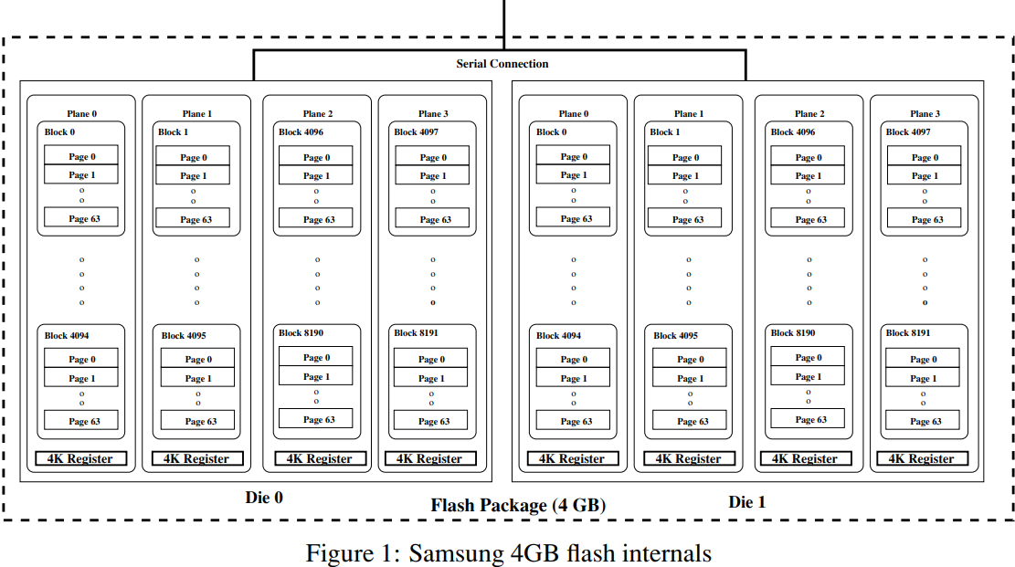
Properties of Flash Memory

Slide 13
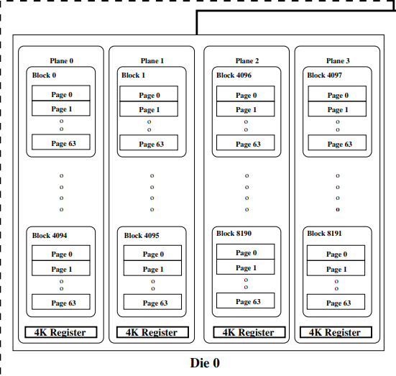
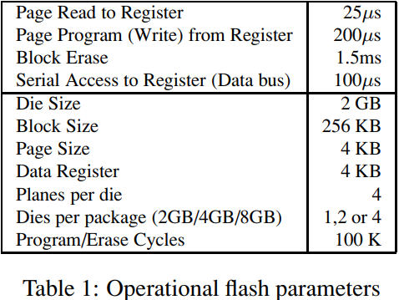
Properties of Flash Memory
25 ns/byte | 100 ns/page

Slide 14
Bandwidth and Interleaving
When read :
25 ns/byte | 100 ns/page
Down to
100 μs/page + 25 μs
8000 page/s
32MB/s
Serial task
100 μs/page
10000 page/s
40MB/s
Interleaving Serial task

Slide 15
Bandwidth and Interleaving
When write :
25 ns/byte | 100 ns/page
Down to
100 μs/page + 200 μs
3330 page/s
13 MB/s

Slide 16
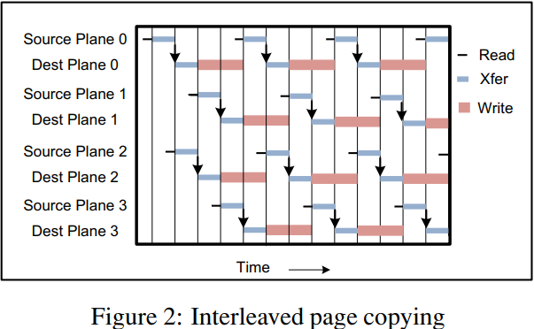
Bandwidth and Interleaving
Page Copy

Slide 17
Bandwidth and Interleaving
Page Program(Write) from Register = 200 μs
Page Copy in the Same Plane = 100 μs
And it supports interleaving operations.

Slide 18
SSD Basics
Logical Block Map
Cleaning
Persistence

Slide 19
Logical Block Map
Physical Block Address / Physical Page Address
Logical Block Mapping / Logical Page Mapping

Slide 20
Logical Block Map
Logical Page Size = Physical Block Size (Max)
Logical Address
Physical Address
= 1/4Physical Page Size (Min)
xxxx1 | x:xx:xxxx:0
xxxx2 | x:xx:xxxx:1
xxxx3 | x:xx:xxxx:2
xxxx4 | x:xx:xxxx:3
xxxx5 | x:xx:xxxx:4
xxxx6 | x:xx:xxxx:5
xxxx7 | x:xx:xxxx:6
xxxx8 | x:xx:xxxx:7
Static Map
Dynamic Map
Translation Table
Allocation Pool

Slide 21
Logical Block Map
Logical Page Size = Physical Block Size (Max)
Parallel
= 1/4Physical Page Size (Min)
When Logical Page Size < Block Size
Page Span
Allocation Pool
Physical Block

Slide 22
Cleaning
Logical Page Size
Block Size
xxxx1 | x:xx:xxxx:0
xxxx2 | x:xx:xxxx:1
xxxx3 | x:xx:xxxx:2
xxxx4 | x:xx:xxxx:3
xxxx5 | x:xx:xxxx:4
xxxx6 | x:xx:xxxx:5
xxxx7 | x:xx:xxxx:6
xxxx8 | x:xx:xxxx:X
Physical Block

Slide 23
Cleaning
xxxx1 | x:xx:xxxx:0
xxxx2 | x:xx:xxxx:1
xxxx3 | x:xx:xxxx:2
xxxx4 | x:xx:xxxx:3
xxxx5 | x:xx:xxxx:4
xxxx6 | x:xx:xxxx:5
xxxx7 | x:xx:xxxx:6
xxxx8 | x:xx:xxxx:X
Physical Block

Slide 24
Cleaning
Clean & Wear Leveling
xxxx1 | x:xx:xxxx:0
xxxx2 | x:xx:xxxx:1
xxxx3 | x:xx:xxxx:2
xxxx4 | x:xx:xxxx:3
xxxx5 | x:xx:xxxx:4
xxxx6 | x:xx:xxxx:5
xxxx7 | x:xx:xxxx:6
xxxx8 | x:xx:xxxx:Y
Physical Block

Slide 25
Cleaning
The worst case
New Data
or
GC
Hidden Block
Physical Block in Plane

Slide 26
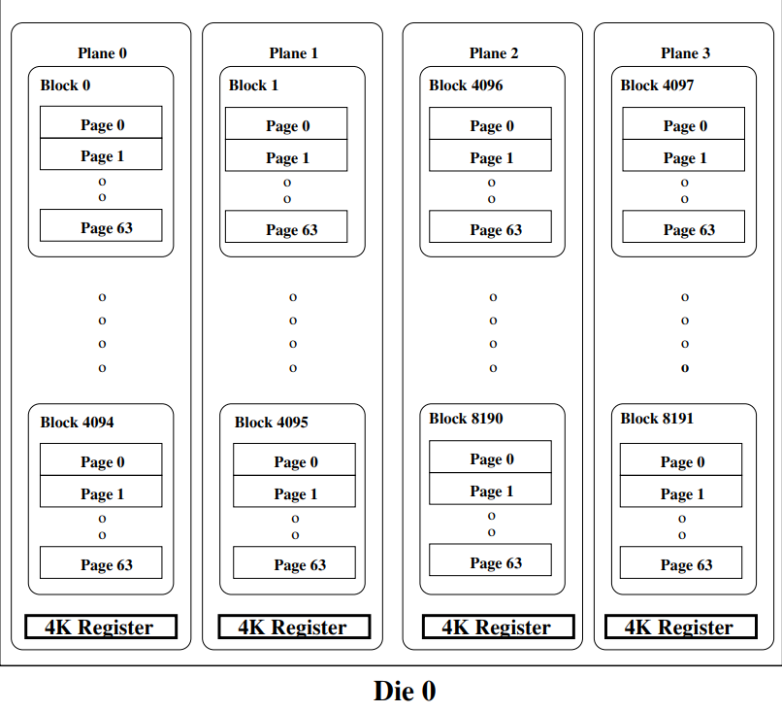
Parallelism and Interconnect Density
A 4KB space composed of cells.
With 128 bytes allocated for dedicated metadata for the page.
The page metadata can also include error detection codes to determine which pages are valid.
SSD uses the page metadata to rebuild the Translation Table and Allocation Pool.

Slide 27
Simulation
Simulator
Workloads
Simulation Results

Slide 28
Simulator & Workloads
Simulator
Modified version of DiskSim simulator(CMU Parallel Data Lab)
Emulate storage component such as bus and controllers
Scalability with infrastructure for trace log processing
Add request queue for parallel processing
SSD logical block maps, cleaning state, and wear-leveling state
Background cleaning, gang-size, gang organization (e.g. switched or shared control), interleaving, and overprovisioning
Workloads
TPC-C (Database workloads)
Exchange (Database workload with about a 3:2 read-to-write ratio)
IOzone & Postmark (Standard file system benchmarks)

Slide 29
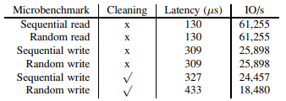
Simulation results - Microbenchmark
Enabled Cleaning
Default
Fully connected 8 flash package
(All of flash package directly connected controller = Operate independently = Parallel processing => Same latency Seq I/O & Ran I/O)
Allocation pool = Size of flash package
Logical page & Stripe(for RAID) : 4KB
Cleaning (Garbage Collection)
Write operations is an additional overhead
Overhead: Seq I/O < Ran I/O (Seq I/O is better cleaning)

Slide 30
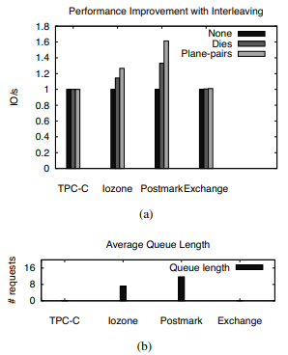
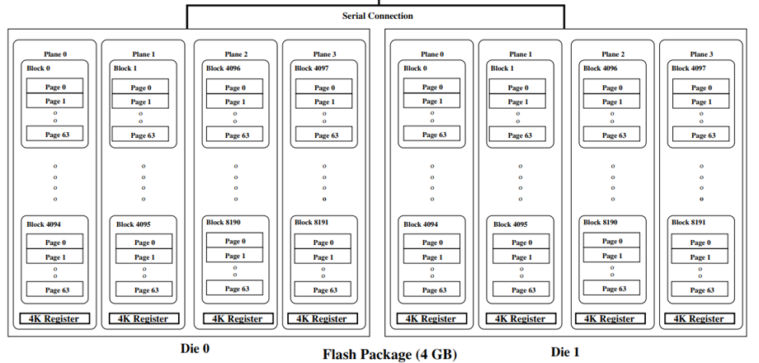
Simulation results - Interleaving
Interleaving means a technique for processing multiple tasks in turn (Parallel processing for performance)
Queuing means managing multiple requests in a certain order as they arrive
TPC-C & Exchange: No interleaving occurs without queuing

Slide 31
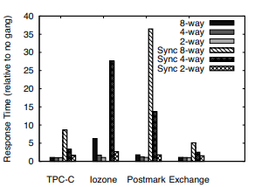
Simulation results - Gang Performance
Gang means to group packages so that they work simultaneously with shared control (package independently)
Synchronous Shared Control Gang
All flash packages in a gang do the same thing at the same time
All pages within a gang have the same data -> gang's logical page size is large
Suitable for workloads that need to process large amounts of data at once
Asynchronous Shared Control Gang
Each flash package in the gang works independently
Additional overhead in synchronizing packages in a gang
Suitable for workloads with random access patterns
Optimize SSD performance and lifespan

Slide 32

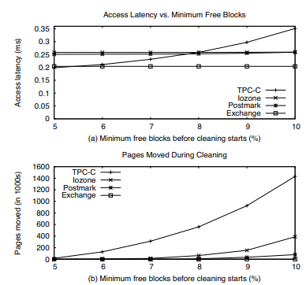
Simulation results - Page Transfer & Cleaning Threshold
Copy-back: Moving a valid page to another block in the same plane (source & destination blocks are in one plane)
Inter-plane: Moving a valid page to a block in another plane (source & destination blocks are different planes)
IOzone & Postmark: perfect cleaning efficiency (move no pages during cleaning)
Need free blocks
Increasing free block’s rate
More cleaning
More page transfer

Slide 33
Wear-leveling
Algorithm
Simulation result

Slide 34

Wear-leveling & Simulation result
Wear-leveling algorithms
Greedy with lifetime threshold : main algorithm - The basic goal of the Greedy strategy is the most efficient cleaning - Considering the remaining lifetime (Exceeding threshold)
Rate-limiting : assistant algorithm - The recycling probability is proportional to the remaining life of the block (linearly from 1 to 0 : 80% ~ 0%)
Migration : assistant algorithm - Migrate cold data into old blocks

Slide 35
Conclusion

Slide 36
Conclusion
The performance of an SSD is determined by a complex interaction between hardware and software components and the workload.
A simulation-based technique for modeling SSD performance is presented, and a new algorithm is proposed, showing that various techniques can benefit the design.
Validates SSD performance modeling using traces extracted from real hardware, helping to understand performance trade-offs for different workloads and components.

Slide 37
Appendix
LFS with FTL

Slide 38
Appendix
FTL (Flash Translation Layer)
File system
Logical address -> Physical address (mapping table)
Read Sectors
Write Sectors
Mismatch
Read Sectors
Write Sectors
FTL
Read
Erase
Write
Read
Erase
Write
Device driver
Flash memory
SSD

Slide 39
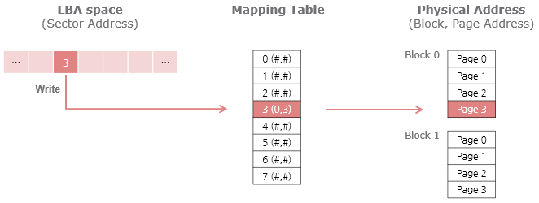
Appendix
FTL (Flash Translation Layer)
https://performance.tistory.com/67

Slide 40
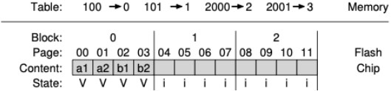
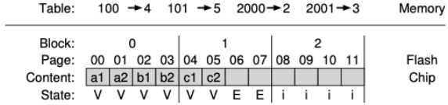
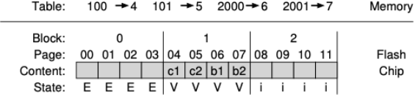
Appendix
Log-Structured FTL
- Key idea: Always write in a new space continuously
: write a1, a2, b1, b2 to address 100, 101, 2000, 2001
: a1, a2 modified to c1, c2 (a1, a2 become garbage)
: cleaning after writing valid pages to the log

Slide 41
2023.07.21
Presentation by Shin Suhwan, 쥬용지에
shshin@dankook.ac.kr
Thank you!
Q & A ?

